Slide 1
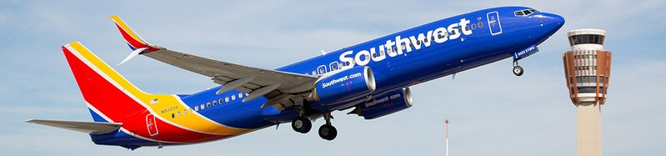

Southwest Airlines – Fly With Us!!

Slide 2
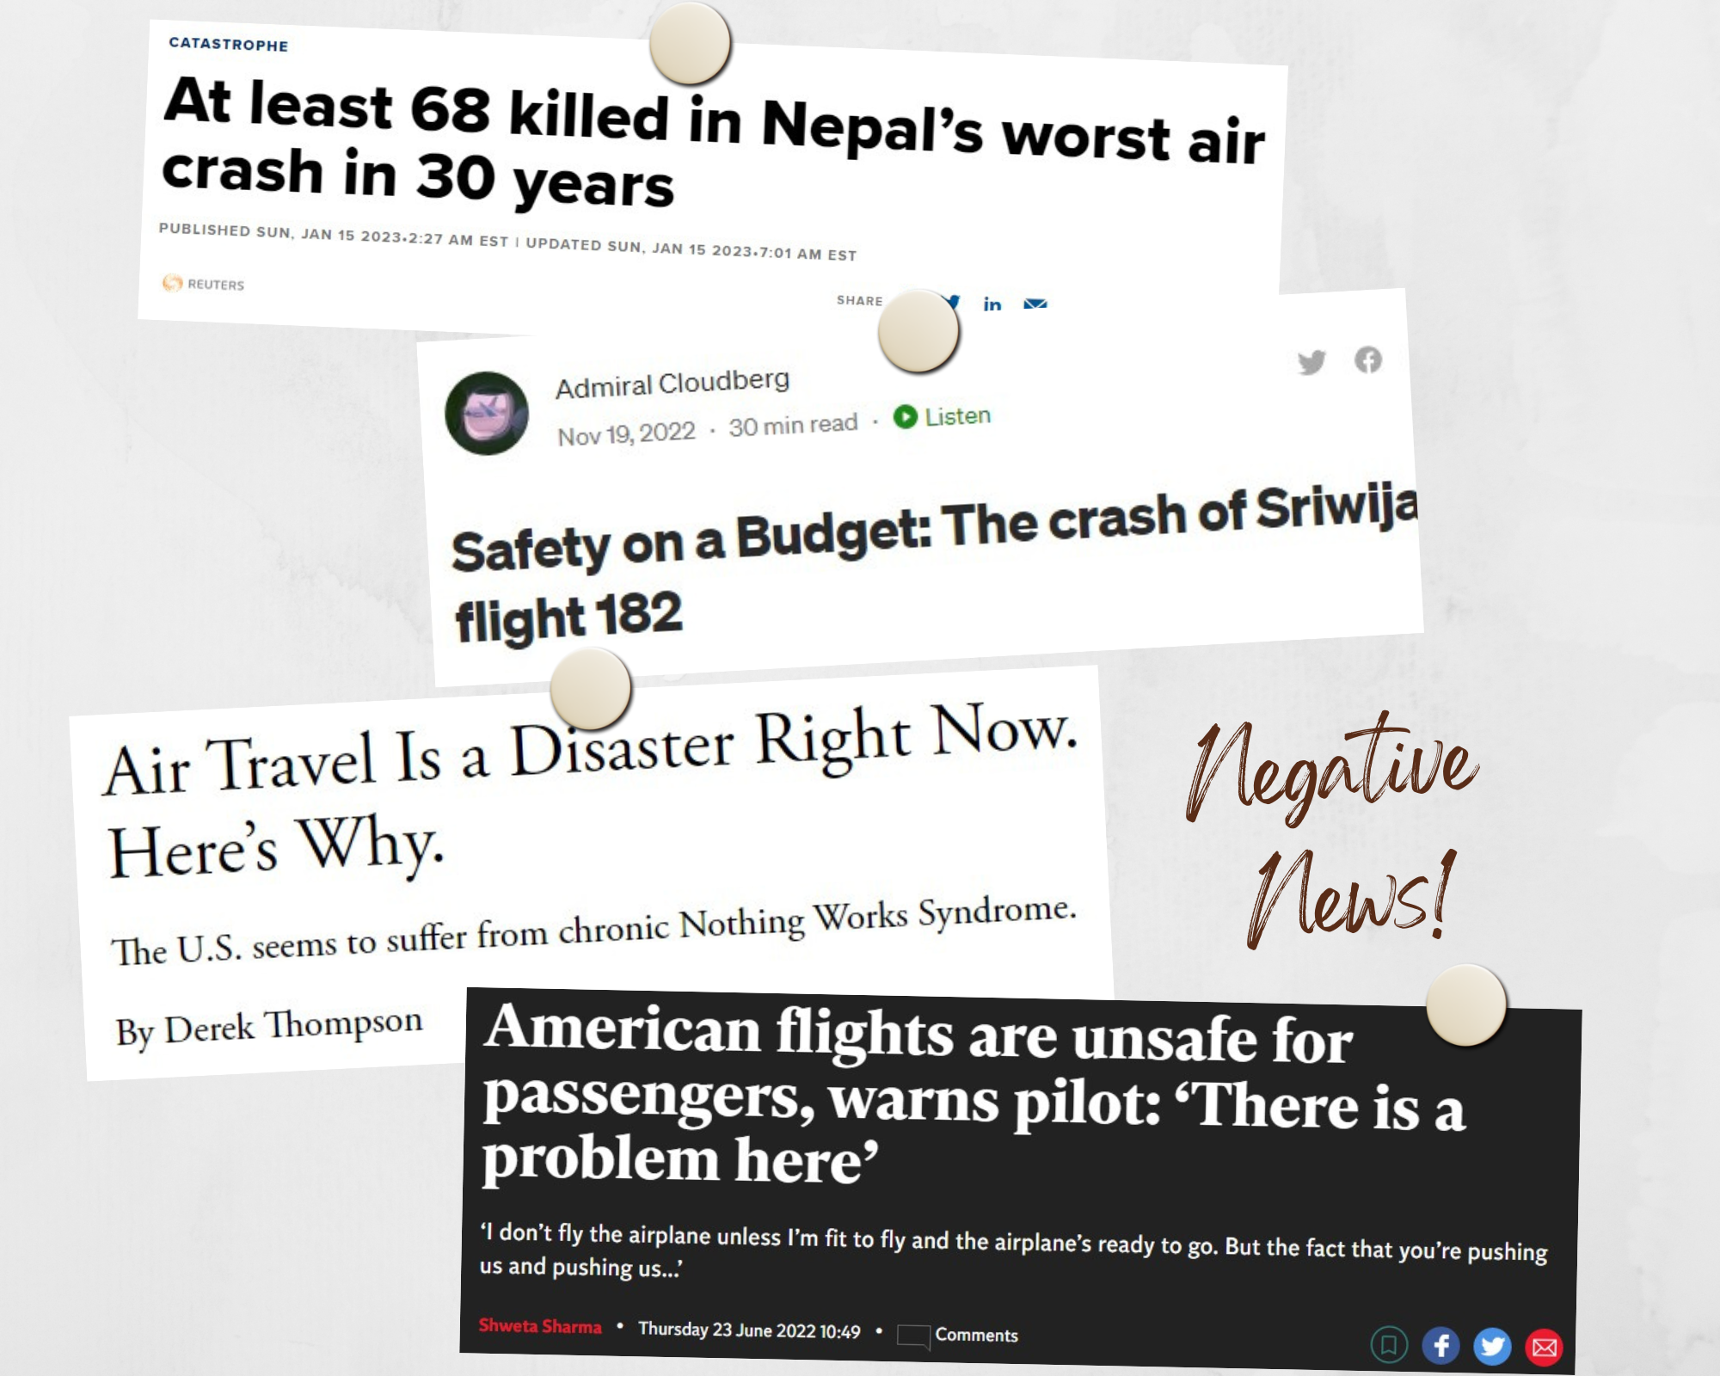

Slide 3
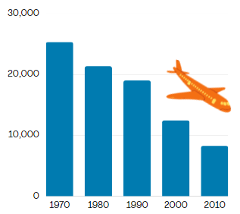

Automobiles vs Airlines
Airline Fatalities
Ratio of fatalities [700:1]
Downward trend

Slide 4
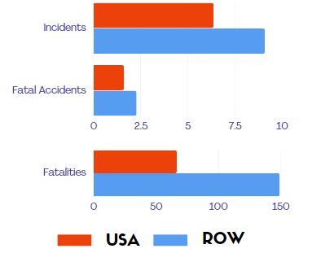
USA vs ROW Airlines
USA Airlines
Superior technology
Safety procedures - FAA
Rest Of World (ROW) Airlines
Technology catching up but still long way to go
Recent Biggest Airline Crashes
Yeti Airlines – Nepal
Sriwijaya Air - Indonesia

Slide 5
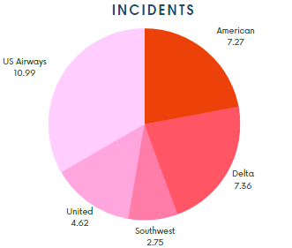
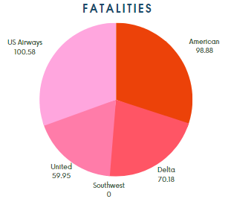
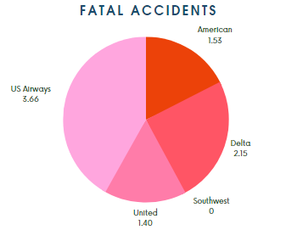
Southwest is safest!
Incidents – Ranks lowest!
Zero Fatal Accidents and Fatalities!

Slide 6
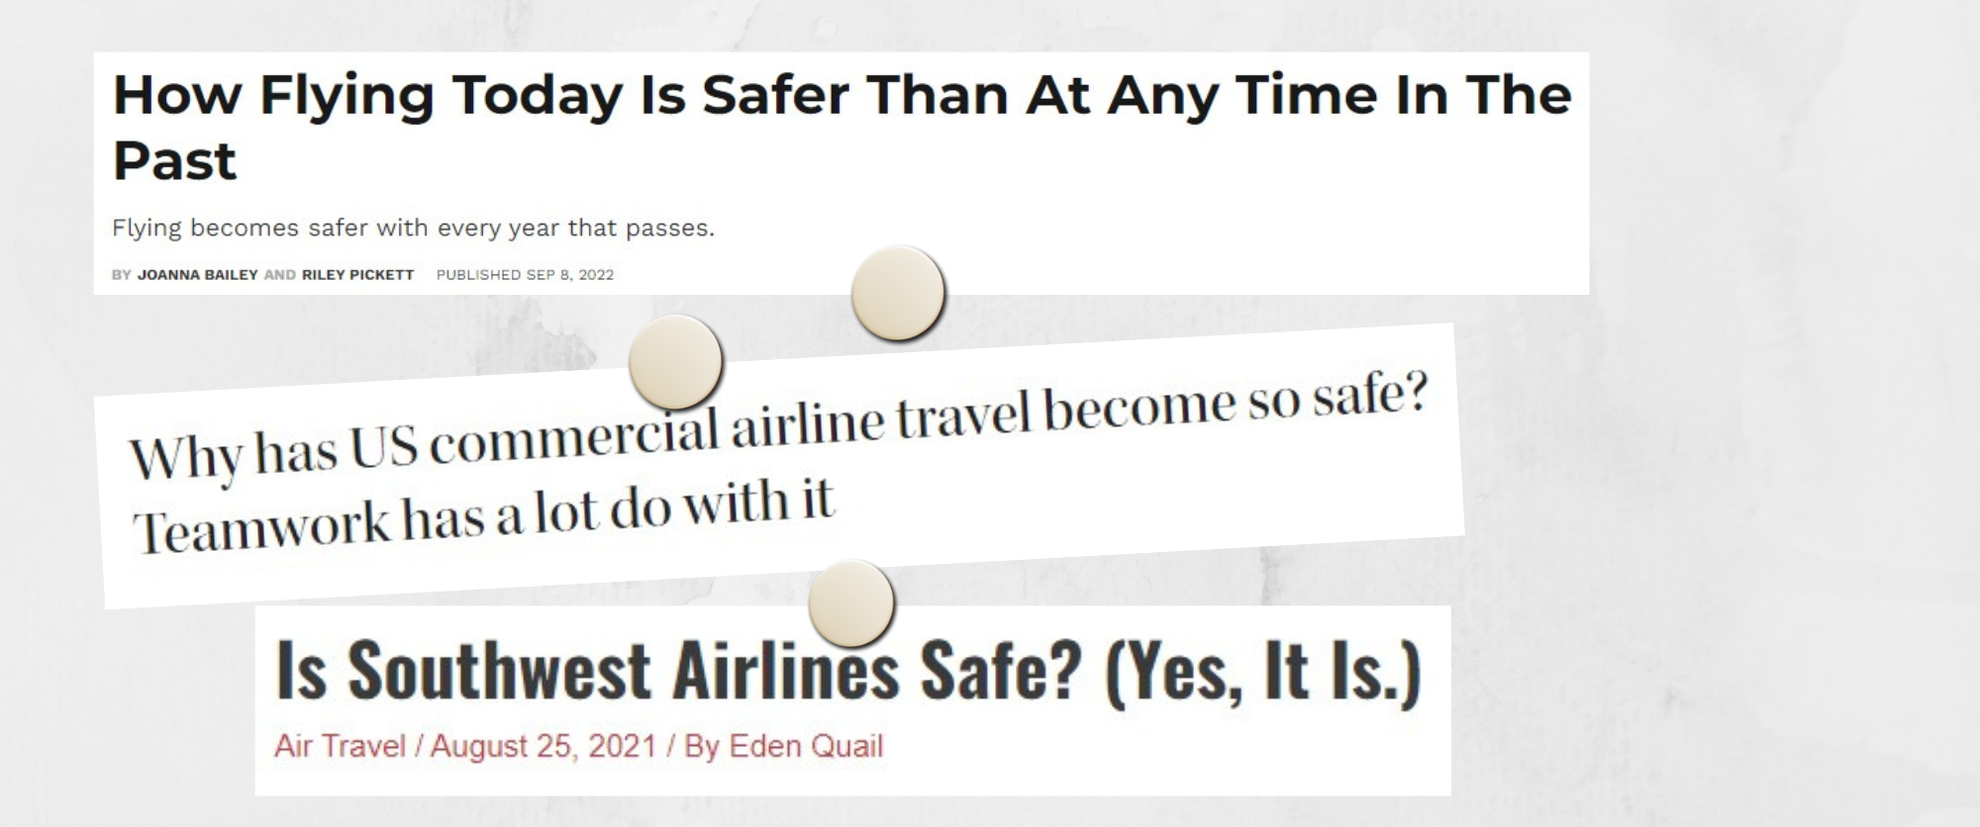
Conclusion
Positive news as well based on facts
Hope to see you on board

